Slide 1

the best & the worst language on the earth

Slide 2

Presentation Layer: PHP
Simple to debug: no need to recompile
Simple to write: loose typing and universal “array”
Simple to read: similar Syntax to C and Java
Simple to learn: small set of expressions and statements

Slide 3
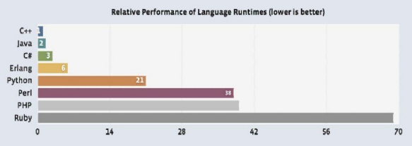
But it’s also a dirty language
High CPU and memory consumption
Interoperability with C++ Challenging
Language doesn’t encourage good programming in the large initialization cost of each page scales with size of code base

Slide 4


Slide 5
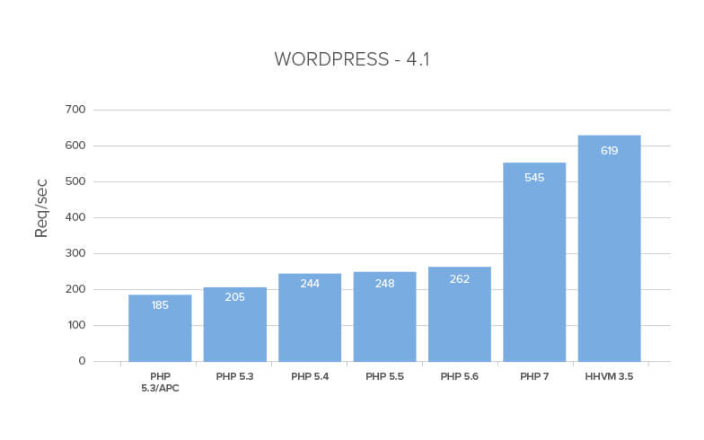

Slide 6
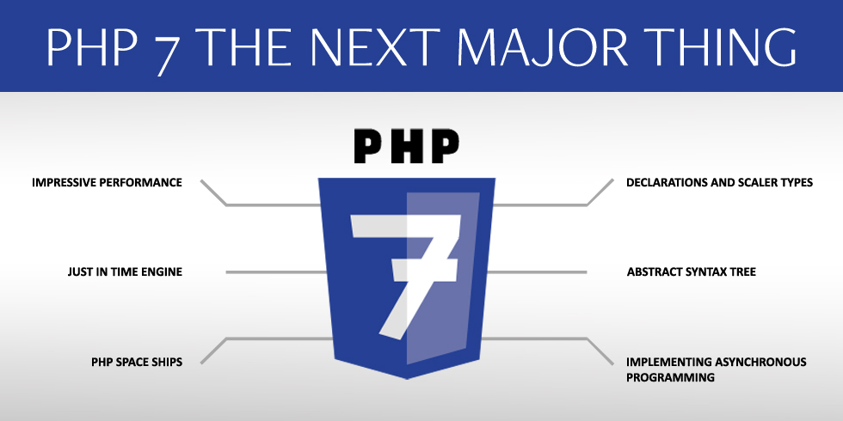

Slide 7
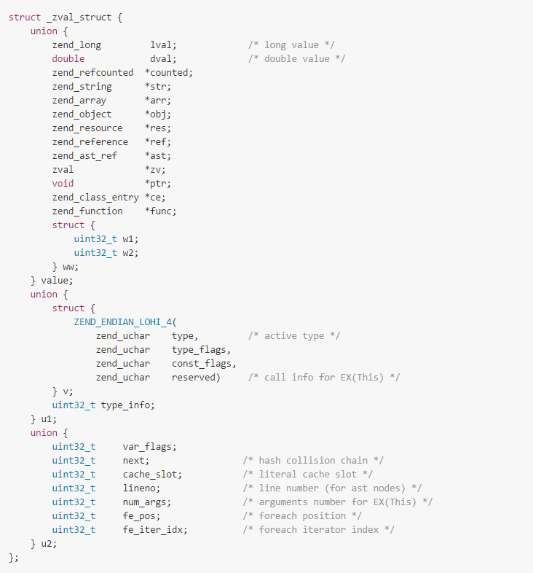
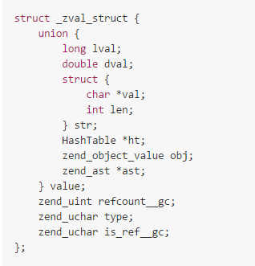
4个uint32_t 长度（无论32位，还是64位，int32_t 都是 4字节）

Slide 8

HHVM
HipHop is a source code transformer which transforms PHP source code into highly optimized C++ and then compiles it using g++.
50% reduction in CPU usage than PHP 5.6
Facebooks’s API tier can serve twice the traffic using 30% less CPU
It’s compatible with PHP 5.6

Slide 9
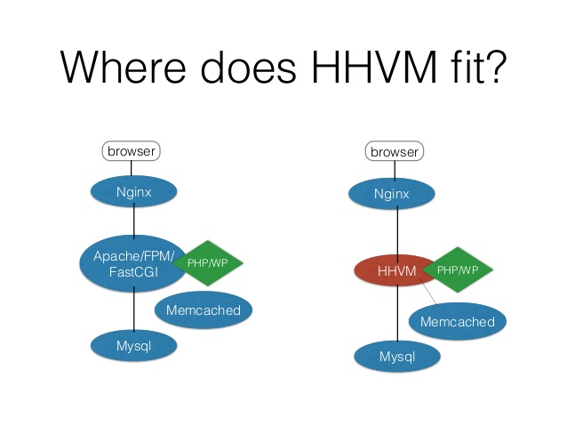

Slide 10
